Slide 1
Same-Day Antiretroviral Therapy Initiation in Thailand: Different Models and Initial Outcomes from Scale-Up in 6 Provinces in Thailand
Pich Seekaew, MPH
PREVENTION | Thai Red Cross AIDS Research Centre
USAID LINKAGES Program Thailand
Abstract Number: WEAB0102

Slide 2
Authors
Pich Seekaew,¹ Sorawit Amatavete,¹ Nipat Teeratakulpisarn,¹ Prattana Leenasirimakul,² Suwimon Khusuwan,³ Pornpen Mathajittiphan,⁴ Ampaipith Nilmanat,⁵ Pimpanitta Saenyakul,⁶ Philip Limbumrung,⁶ Amornrat Arunmanakul,⁶ Duangkamon Donchaum,⁶ Klayduean Singhaseni,¹ Ratchadaporn Meksena,¹ Danai Lingjongrat,⁷ Surang Janyam,⁸ Pongthorn Chanlern,⁹ Satayu Sittikarn,¹⁰ Sutinee Charoenying,⁶ Stephen Mills,⁶ Ravipa Vannakit,¹¹ Praphan Phanuphak,¹ Nittaya Phanuphak¹
¹ PREVENTION, Thai Red Cross AIDS Research Centre, Bangkok, Thailand, ² Nakornping Hospital, Chiang Mai, Thailand, ³ Chiangrai Prachanukroh Hospital, Chiang Rai, Thailand, ⁴ Queen Savang Vadhana Memorial Hospital, Chonburi, Thailand, ⁵ Hat Yai Hospital, Songkhla, Thailand, ⁶ FHI 360 and LINKAGES, Bangkok, Thailand, ⁷ Rainbow Sky Association of Thailand, Bangkok, Thailand, ⁸ The Service Workers In Group Foundation, Bangkok, Thailand, ⁹ Mplus Foundation, Chiang Mai, Thailand, ¹⁰ Caremat, Chiang Mai, Thailand, ¹¹ Office of Public Health, USAID Regional Development Mission Asia, Bangkok, Thailand

Slide 3
Outline
Background
Same-Day ART Models
Outcome Measures
Conclusions
Next Steps

Slide 4
Progress Towards 90-90-90 in Thailand, 2017
Source: https://www.unaids.org/sites/default/files/media_asset/unaids-data-2018_en.pdf

Slide 5
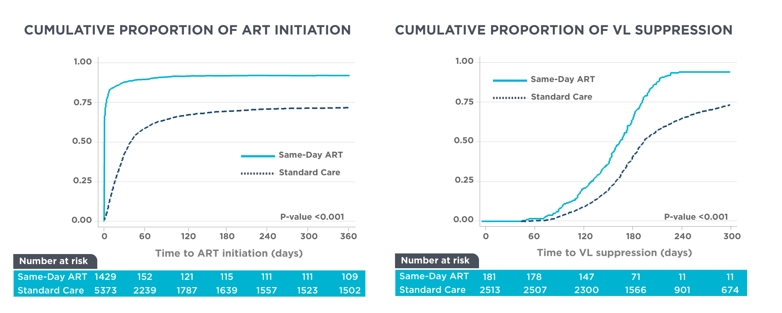
Same-Day ART at Thai Red Cross Anonymous Clinic (Bangkok, Thailand)
THAC0403
Those in Same-Day ART program were 3.9 times more likely to start ART
Those in Same-Day ART program were
2.2 times more likely to be viral suppressed
(Seekaew P, et al. AIDS 2018, Abstract: THAC0403)

Slide 6
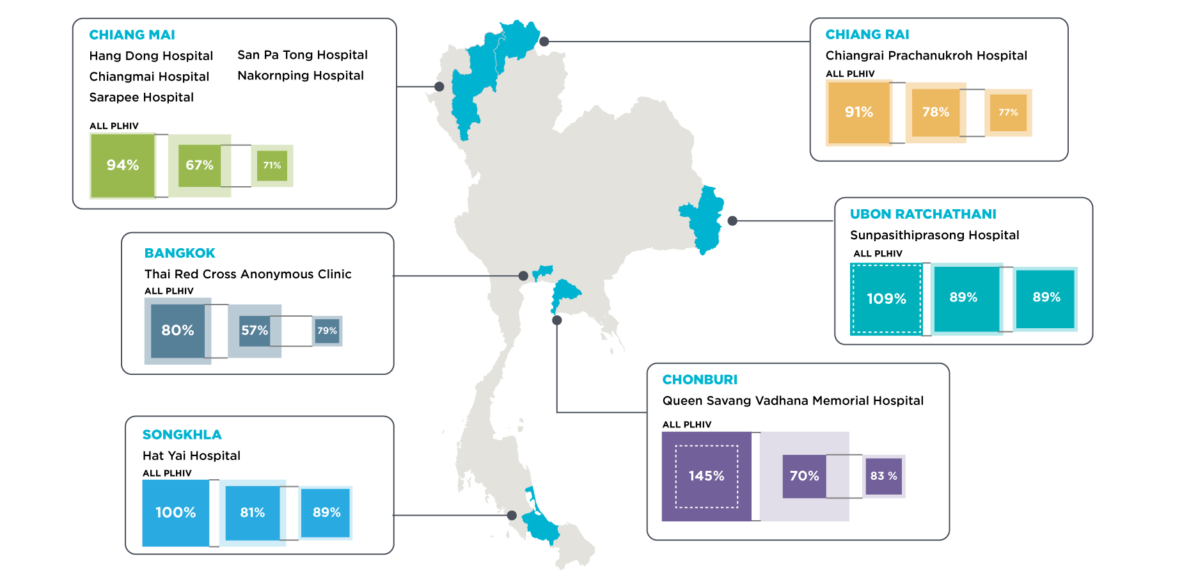
Same-Day ART Implementation Sites Progress & Towards 90-90-90 in High HIV Burden Provinces, 2016
6 provinces
9 hospitals +
1 VCT center
Source:
1) National AIDS Database, National Heath Security Office (NHSO), 2017
2) AIDS and STI section, Bangkok Metropolitan Administration (BMA).Strategic Plan for Ending AIDS in Bangkok 2017 – 2030

Slide 7
Objectives
Describe different models of Same-Day ART initiation
Assess the overall performance of Same-Day ART initiation
Evaluate baseline laboratory-specific models of Same-Day ART initiation

Slide 8
Common Features
Chest X-Ray
History Assessment
Physical Examination

Slide 9
Key Considerations for Same-Day ART Implementation
When? Operating Hours for ARV Clinic
Who? ARV Prescribers
What? Baseline Laboratory Testing

Slide 10
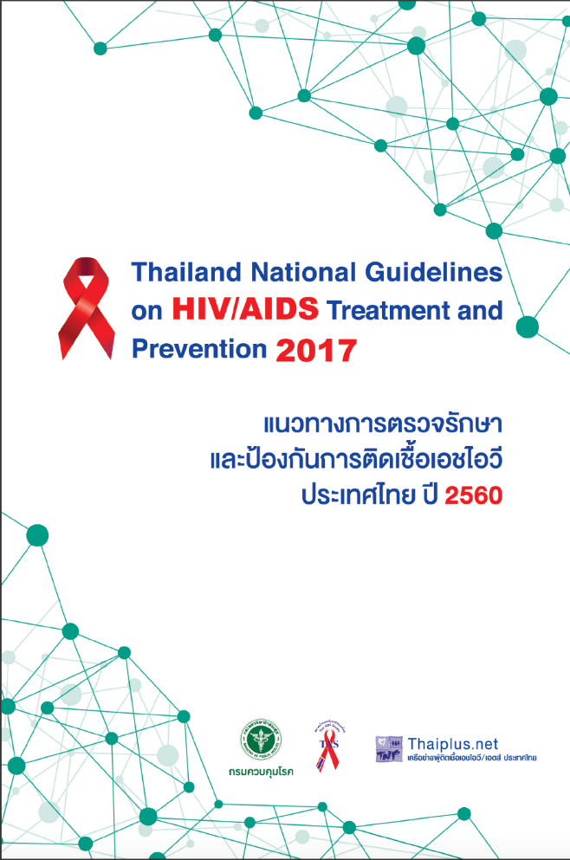
HIV Treatment Algorithm
ART drug regimen:
FTC/TDF + EFV
Baseline tests:
Creatinine
Urinalysis
CD4 count
HBsAg
Anti-HCV
Syphilis serology
ALT
Chest X-Ray
Cryptococcal Ag (CD<100 cells/mm³)

Slide 11
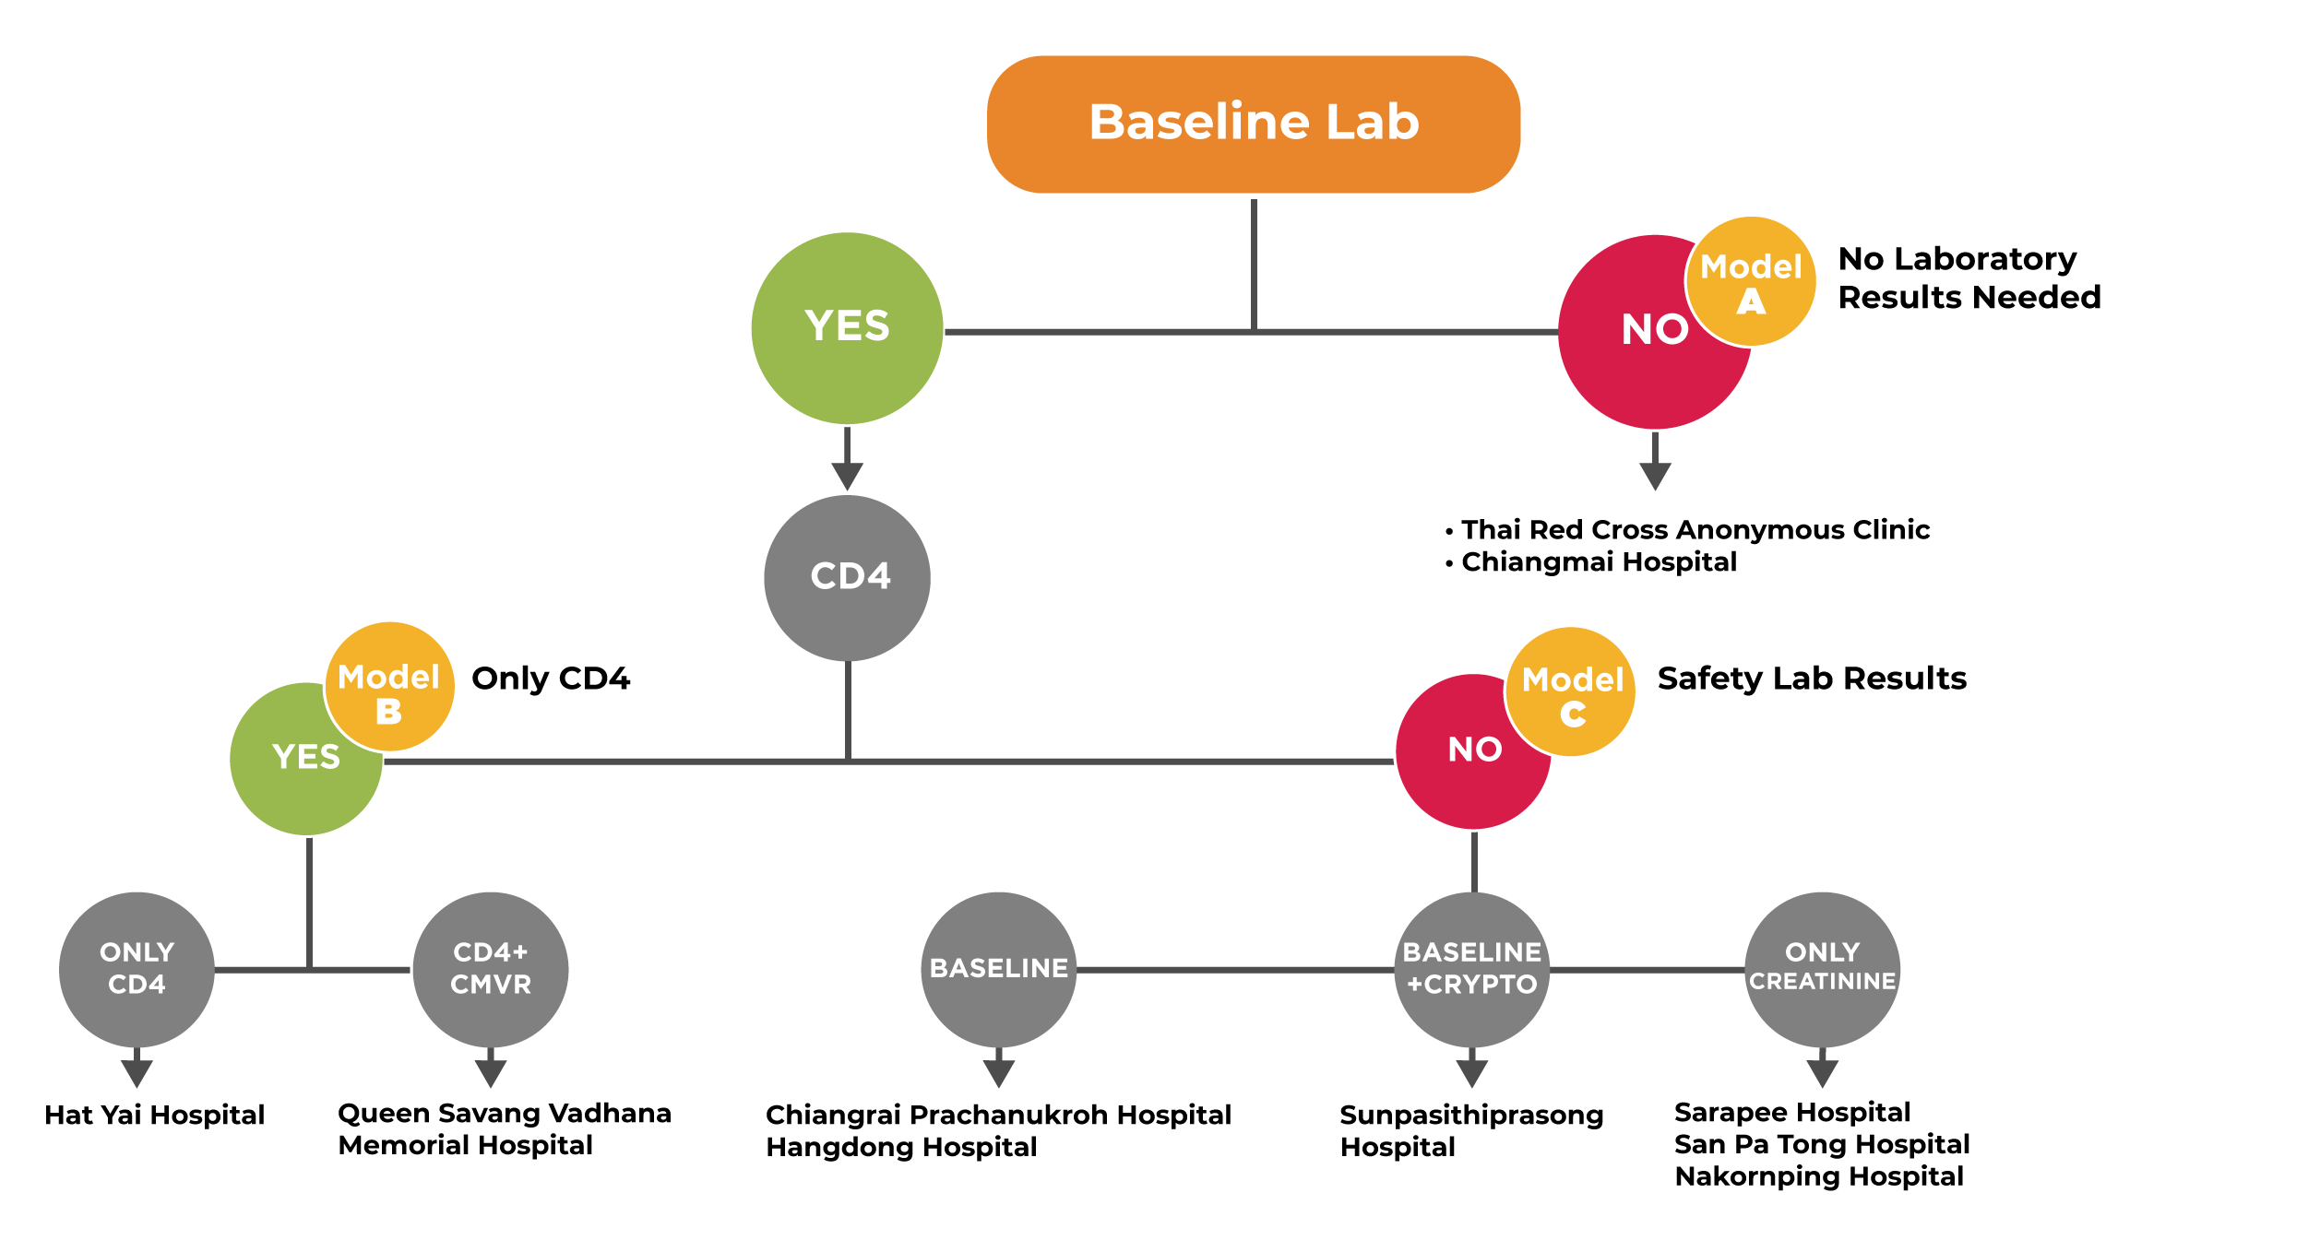
(n=3,465)
(n=408)
(n=476)

Slide 12
Outcome Measures
Observational cohort study from July 2017 to April 2019:
Acceptability
ART initiation rate
Retention at months 3, 6, and 12
Viral load testing and suppression
Baseline laboratory-specific models
ART Initiation time periods
Adverse events and deaths
Multivariable logistic regression model
Factors associated with same-day ART initiation

Slide 13
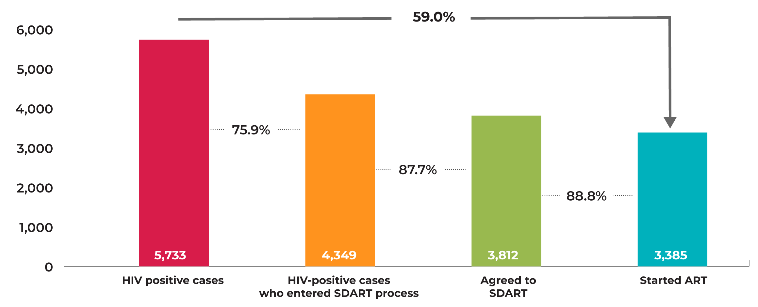
Treatment Cascade

Slide 14
ART Initiation Time Periods
N=3,385

Slide 15
Retention at Month 3 and Month 6

Slide 16
Viral Load Testing and Suppression

Slide 17
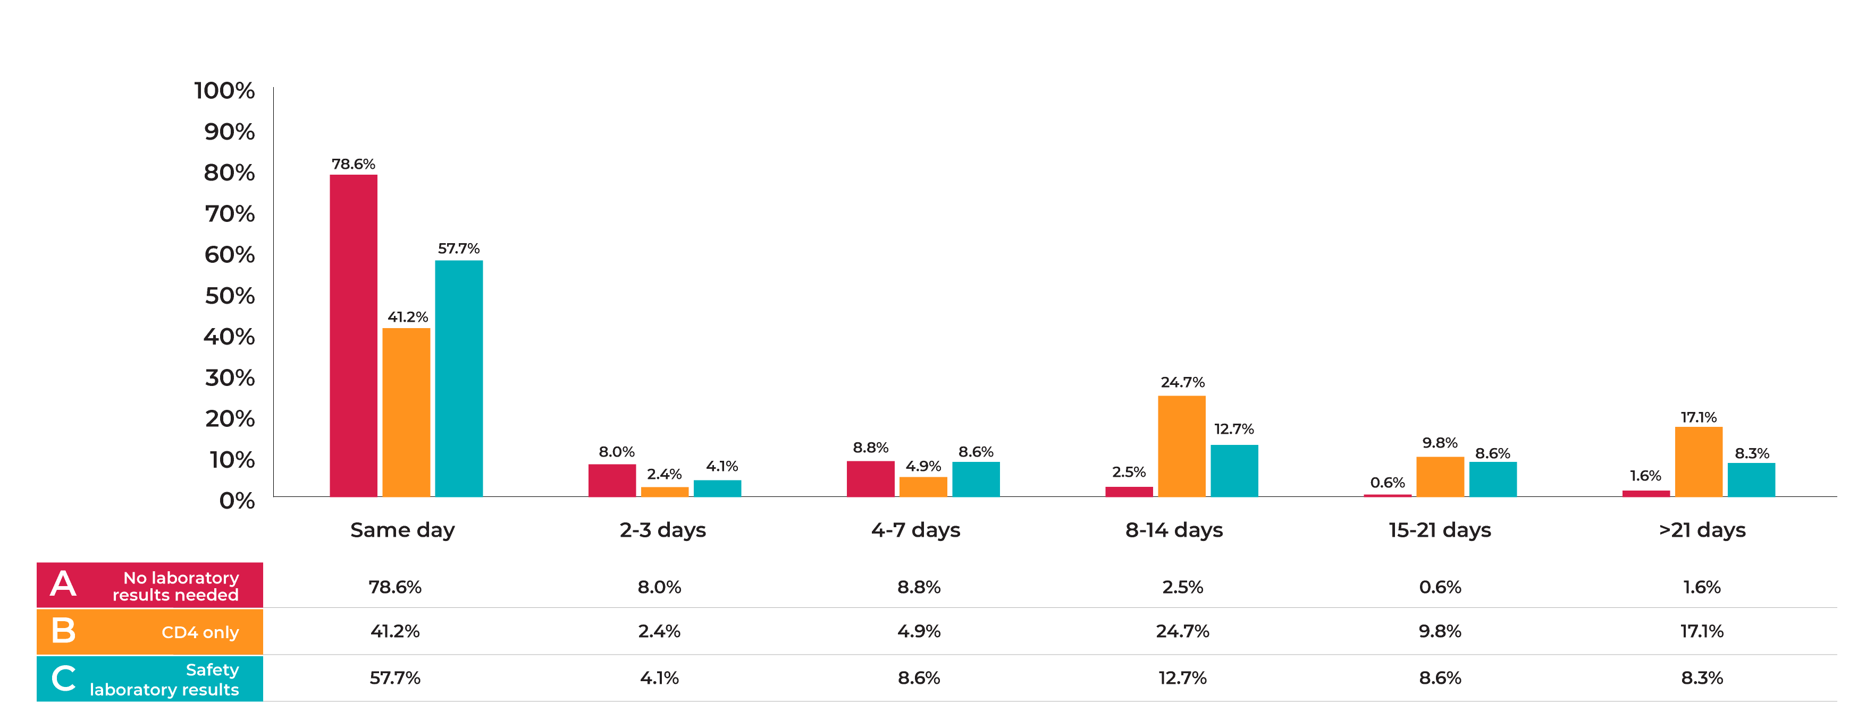
ART Initiation Time Periods
Median (IQR) for Model A = 0 (0-0)
Median (IQR) for Model B = 7 (0-15)
Median (IQR) for Model C = 0 (0-8)
Model A vs. Model B: p <0.001
Model B vs. Model C: p<0.001
Model C vs. Model A: p<0.001

Slide 18
Adverse Events & Death
AE:
Overall: p<0.001
Model A vs. Model B: p=0.026
Model A vs. Model C: p=0.083
Model B vs. Model C: p=0.001
Death:
Overall: p<0.001
Model A vs. Model B: p=0.006
Model A vs. Model C: p=0.012
Model B vs. Model C: p=1.000
A
B
C

Slide 19
Factors Associated with Same-Day ART Initiation
No laboratory results needed
(aOR: 5.48; 95%CI: 3.98-7.65; p<0.001)
Being transgender woman
(aOR: 2.15; 95%CI: 1.24-3.74; p=0.007)
Having monthly income of ≤10,000 THB
(aOR: 1.5; 95%CI: 1.11-2.04; p=0.009)
CD4 101-200 cells/mm³
(aOR: 3.45; 95%CI: 2.13-5.60; p<0.001)
CD4 201-350 cells/mm³
(aOR: 3.19; 95%CI: 2.05-4.98; p<0.001)
CD4 >350 cells/mm³
(aOR: 3.58; 95%CI: 2.31-5.55; p<0.001)
Adjusted for:
Age
Education
eGFR
ALT
HBsAg
Chest X-Ray
aOR= adjusted odds ratio; THB = Thai Baht

Slide 20
Conclusions
Not using baseline laboratory results facilitates faster ART initiation with no increase in severe adverse events or deaths
Needing CD4 counts prior to ART initiation results in longer time to start HIV treatment
Even with infectious disease physicians leading ART services, practices still varied, and some practices were based on anecdotal case reports/experience

Slide 21
Next Steps
Develop standardized clinical guidelines for Same-Day ART
Increase viral load literacy among ART clients
Create ART initiation network within high HIV burden provinces
Assess the influence of Same-Day ART on the 2nd and 3rd 90s on a provincial-level
Assess the disease burden (quality of life) and long-term economic evaluation

Slide 22
Same-Day ART Posters at IAS 2019
Engagement of peer navigators in the multidisciplinary team of providers in the same-day antiretroviral therapy initiation hub model in Bangkok, Thailand (MOPED343)
Transgender-led same-day antiretroviral therapy services at the Tangerine Community Health Center in Bangkok, Thailand (WEPEB311)
Characteristics of clients with sexually transmitted infections and HIV coinfection in same-day antiretroviral therapy cohort in Bangkok, Thailand (TUPEB185)
TDF-based regimens: Are they suitable for same-day antiretroviral treatment initiation without baseline laboratory test results in Thailand? (MOPEB224)

Slide 23
Acknowledgments

